Slide 1


Machine Learning
An Introduction

Slide 2
Definition of ML

Slide 3
Definition of ML
A computer program is said to
learn from experience E with respect to some class of tasks T and performance measure P,
if its performance at tasks in T, as measured by P, improves with experience E.
- Machine Learning, 1997, McGraw-Hill, Tom M. Mitchell (CMU)
T : Task
E : Experience
P : Performance

Slide 4
Definition of ML

Slide 5
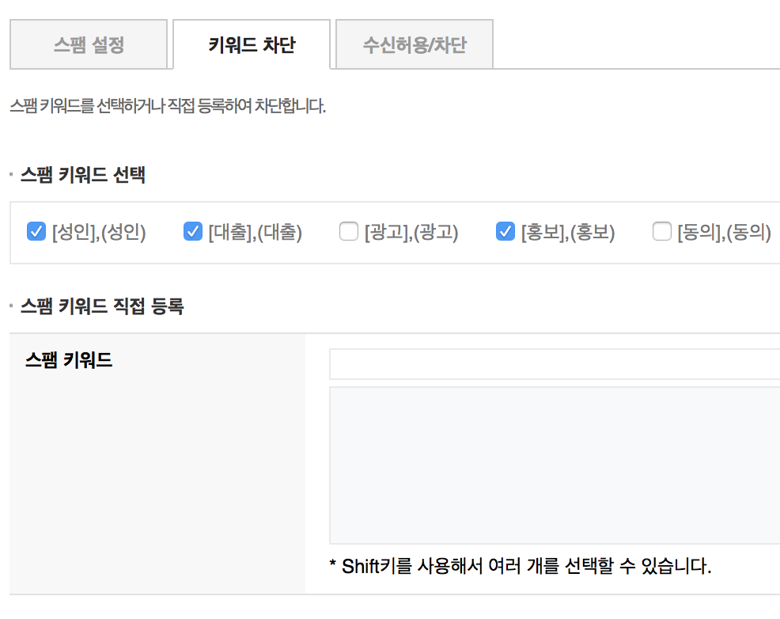
Definition of ML
Ex. Spam Mail Filtering
Knowledge-based or Rule-based
Data driven

Slide 6
Types of problem
Supervised Learning
Regression
Classification
Learning a mapping from inputs to outputs, given a labeled set of input-output pairs
Unsupervised Learning
Clustering
Matrix Completion
Auto-encoder
Finding “interesting patterns” in the data, given inputs
without labels
Reinforcement Learning
Dynamic Planning
Imitation Learning
Model-free RL
Learning how to act in an environment so as to maximize cumulative reward

Slide 7
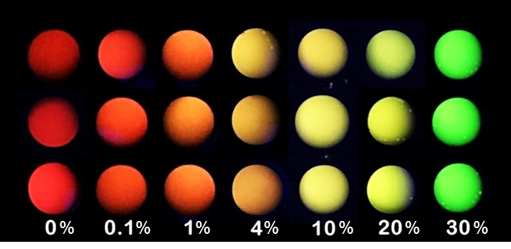
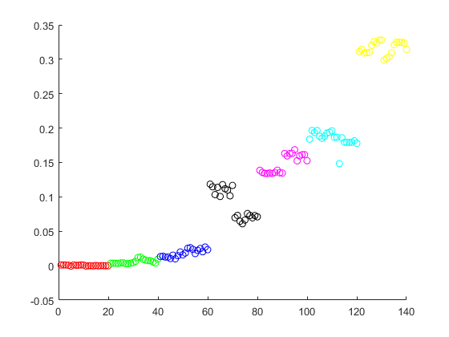
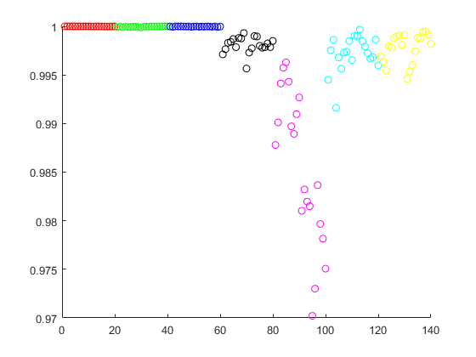
Supervised Learning
Regression
실수값 예측
[Simple, fast, and low-cost camera-based water content measurement with colorimetric fluorescent indicator, JOLT, 2018]
H
S
$$f\left(x\right)=a_{0}H^{2}+a_{1}H+a_{2}HS+a_{3}S+a_{4}S^{2}+b$$

Slide 8
Supervised Learning
Classification
Image classification

Slide 9
Supervised Learning
Classification

Slide 10
Unsupervised Learning
Clustering
Image Segmentation
Anomaly Detection

Slide 11
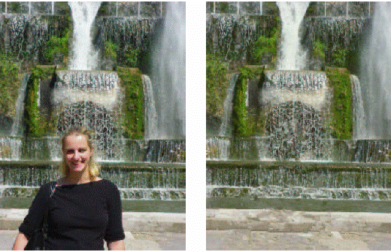
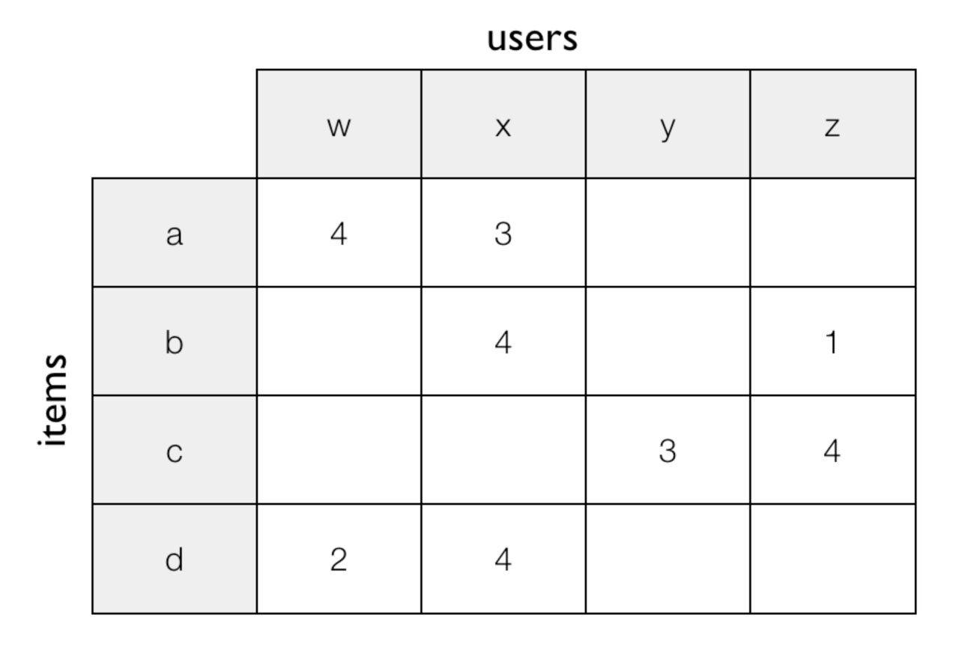
Unsupervised Learning
Matrix Completion
Image Inpainting
Collaborative Filtering
Ex) BellKor’s Pragmatic Chaos in Netflix Prize

Slide 12
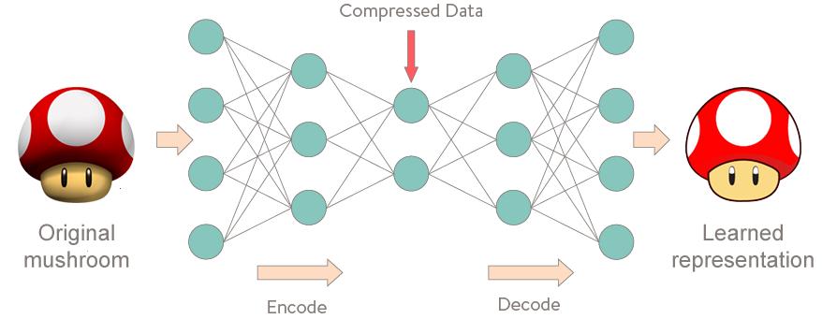
Unsupervised Learning
Auto-encoder

Slide 13
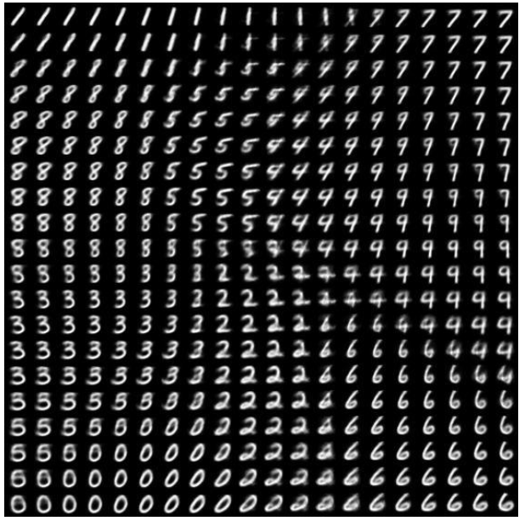
Unsupervised Learning
Auto-encoder
Manifold Learning
(차원 축소)
Denoising

Slide 14

Reinforcement Learning
AlphaGo

Slide 15
Datasets
Training set
Validation set
Test set
모델의 학습
파라미터 결정
모델의 평가
K-fold cross validation

Slide 16
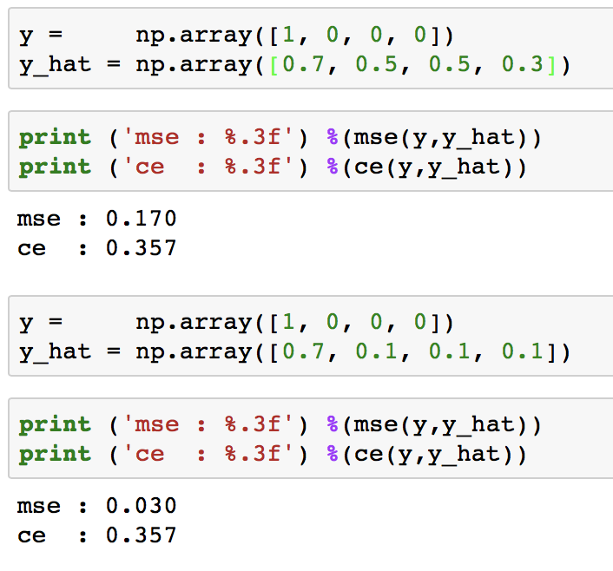
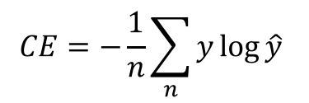
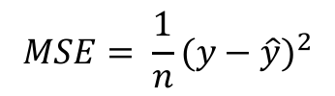
Cost Function
or Loss Function
학습과정에서 최소화 하고자 하는 함수
학습을 위해 미분 가능해야 함.
$$MSE= \frac{1}{n}(y−\hat{y})^{2}$$
$$CE=−\frac{1}{n}\sum_{n}{y\log{\hat{y}} }$$

Slide 17

Optimization
Gradient Descent

Slide 18


Optimization
Various Algorithms

Slide 19
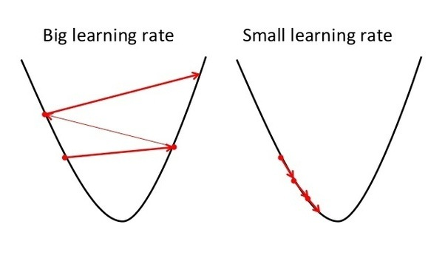
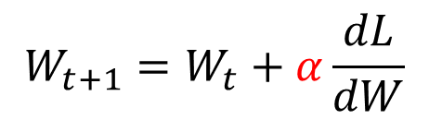
Optimization
Learning rate
$$W_{t+1}=W_{t}+α\frac{dL}{dW}$$

Slide 20
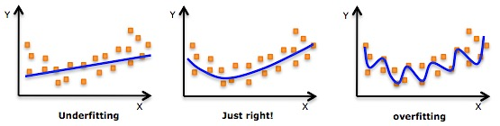
Overfitting vs. Underfitting
모델을 줄여
데이터를 늘려
모델을 키워
혹은 비선형을 써
ML의 핵심은 표현(representation)과 일반화(generalization)에 있다.
Occam’s razor: All things being equal, the simplest solution tends to be the best one.

Slide 21

Overfitting vs. Underfitting

Slide 22
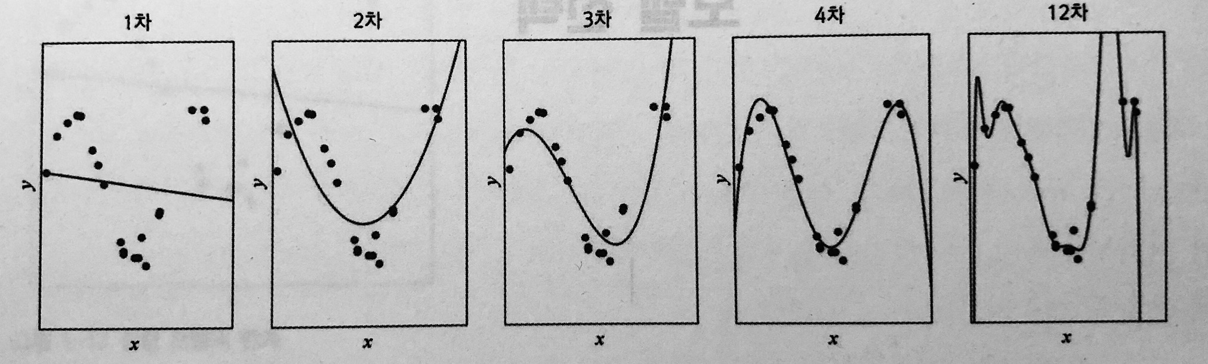
Bias & Variance
Bias
Variance
실제 데이터와 모델의 예측 값의 차이
학습할 때 마다 모델이 달라지는 정도(?)
단순한 모델일수록 bias는 크고 variance는 작다.
Bias
Variance
Tradeoff

Slide 23
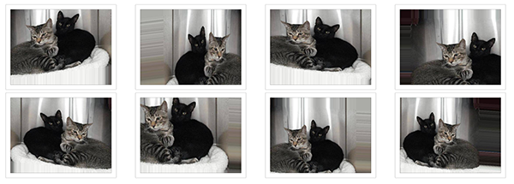
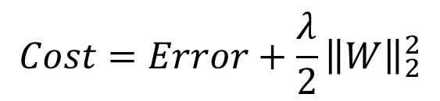
Regularization (일반화)
Data 늘리기 or Data Augmentation
Weight Decay
$$Cost=Error+\frac{λ}{2}{\left\|W\right\|}_{2}^{2}$$

Slide 24
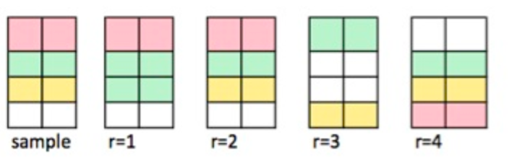
Data Bootstrap
난수를 이용하여, 같은 샘플이 여러 번 뽑힐 수 있게 데이터 샘플링

Slide 25
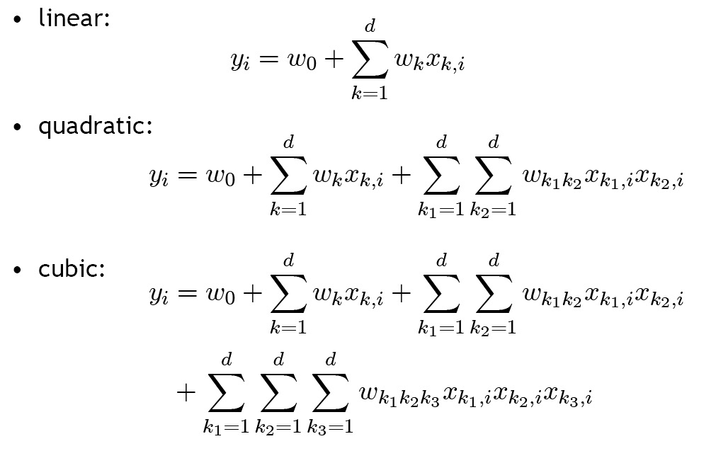
Curse of Dimensionality
다항식의 차원을 늘릴수록 표현력은 커지지만 parameter 수가 급증함

Slide 26
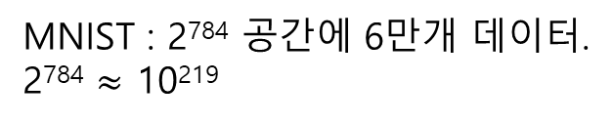
Curse of Dimensionality
MNIST : 2⁷⁸⁴ 공간에 6만개 데이터.
2⁷⁸⁴ $≈$ 10²¹⁹
MNIST dataset

Slide 27
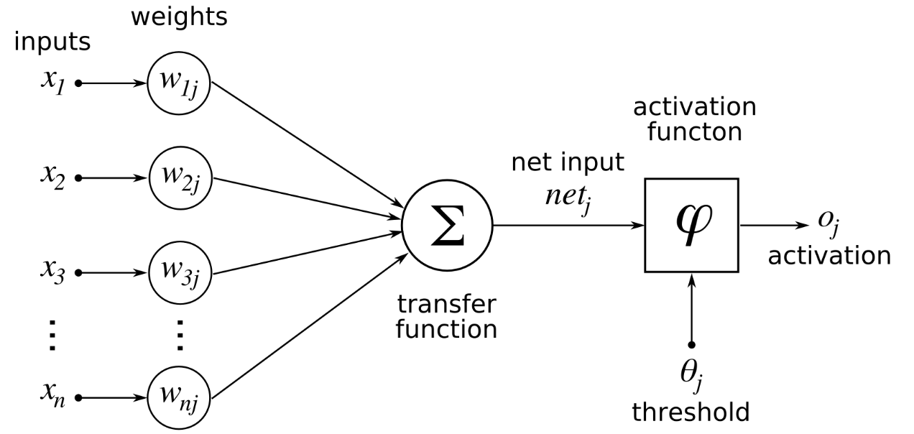
Terminologies
Weight (가중치) / Parameter / Bias
학습할 대상
b

Slide 28
Terminologies
Class / Label / Ground truth / One-hot coding
Cat
0
[1 0 0 0]
Dog
1
[0 1 0 0]
Cow
2
[0 0 1 0]
Horse
3
[0 0 0 1]

Slide 29
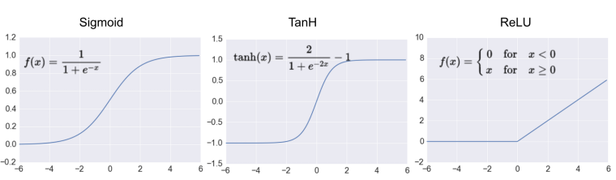
Terminologies
Activation Function (활성함수)

Slide 30
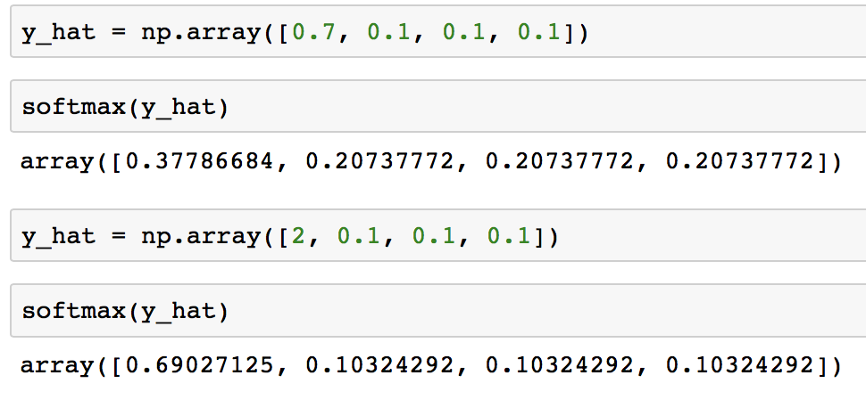
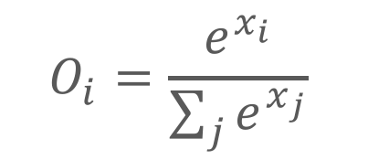
Terminologies
Softmax function
Output을 확률로 바꿔줌
$$O_{i}=\frac{e^{x_{i}}}{\sum_{j}{e^{x_{j}}}}$$

Slide 31
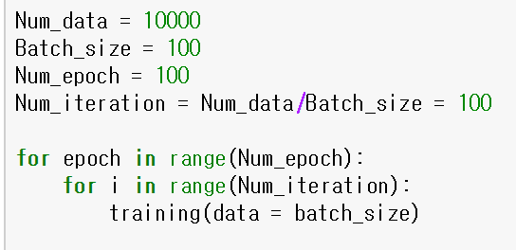
Terminologies
Epoch / Batch / Iteration
Epoch : 전체 데이터를 한번 학습하는 단위
Batch : 한번 학습에 사용 되는 데이터 수
Iteration : batch 데이터 한번 계산

Slide 32
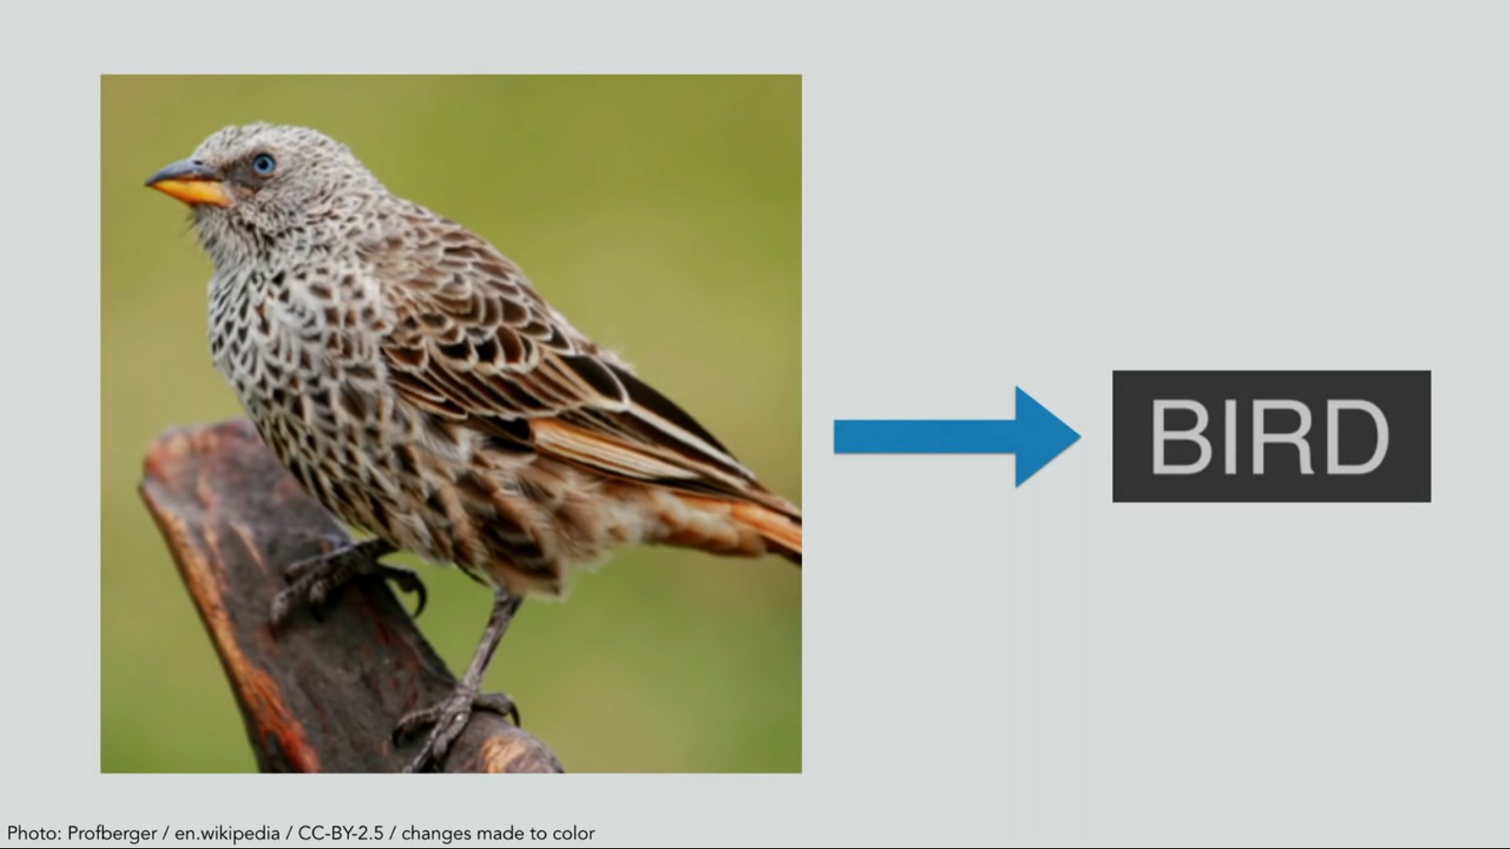
Intuition

Slide 33
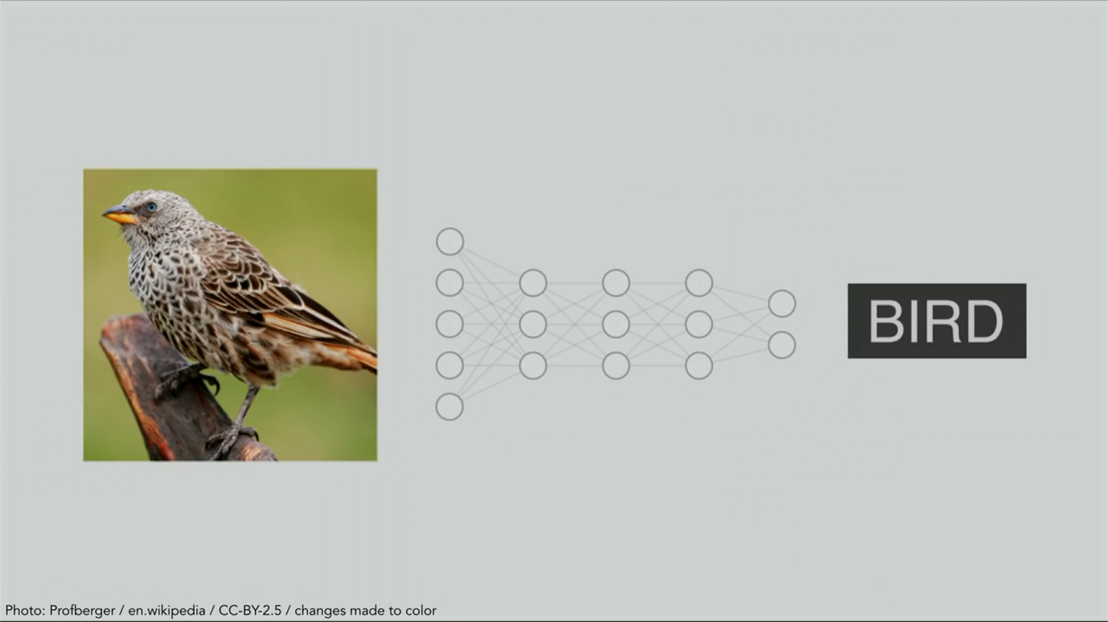
Intuition

Slide 34
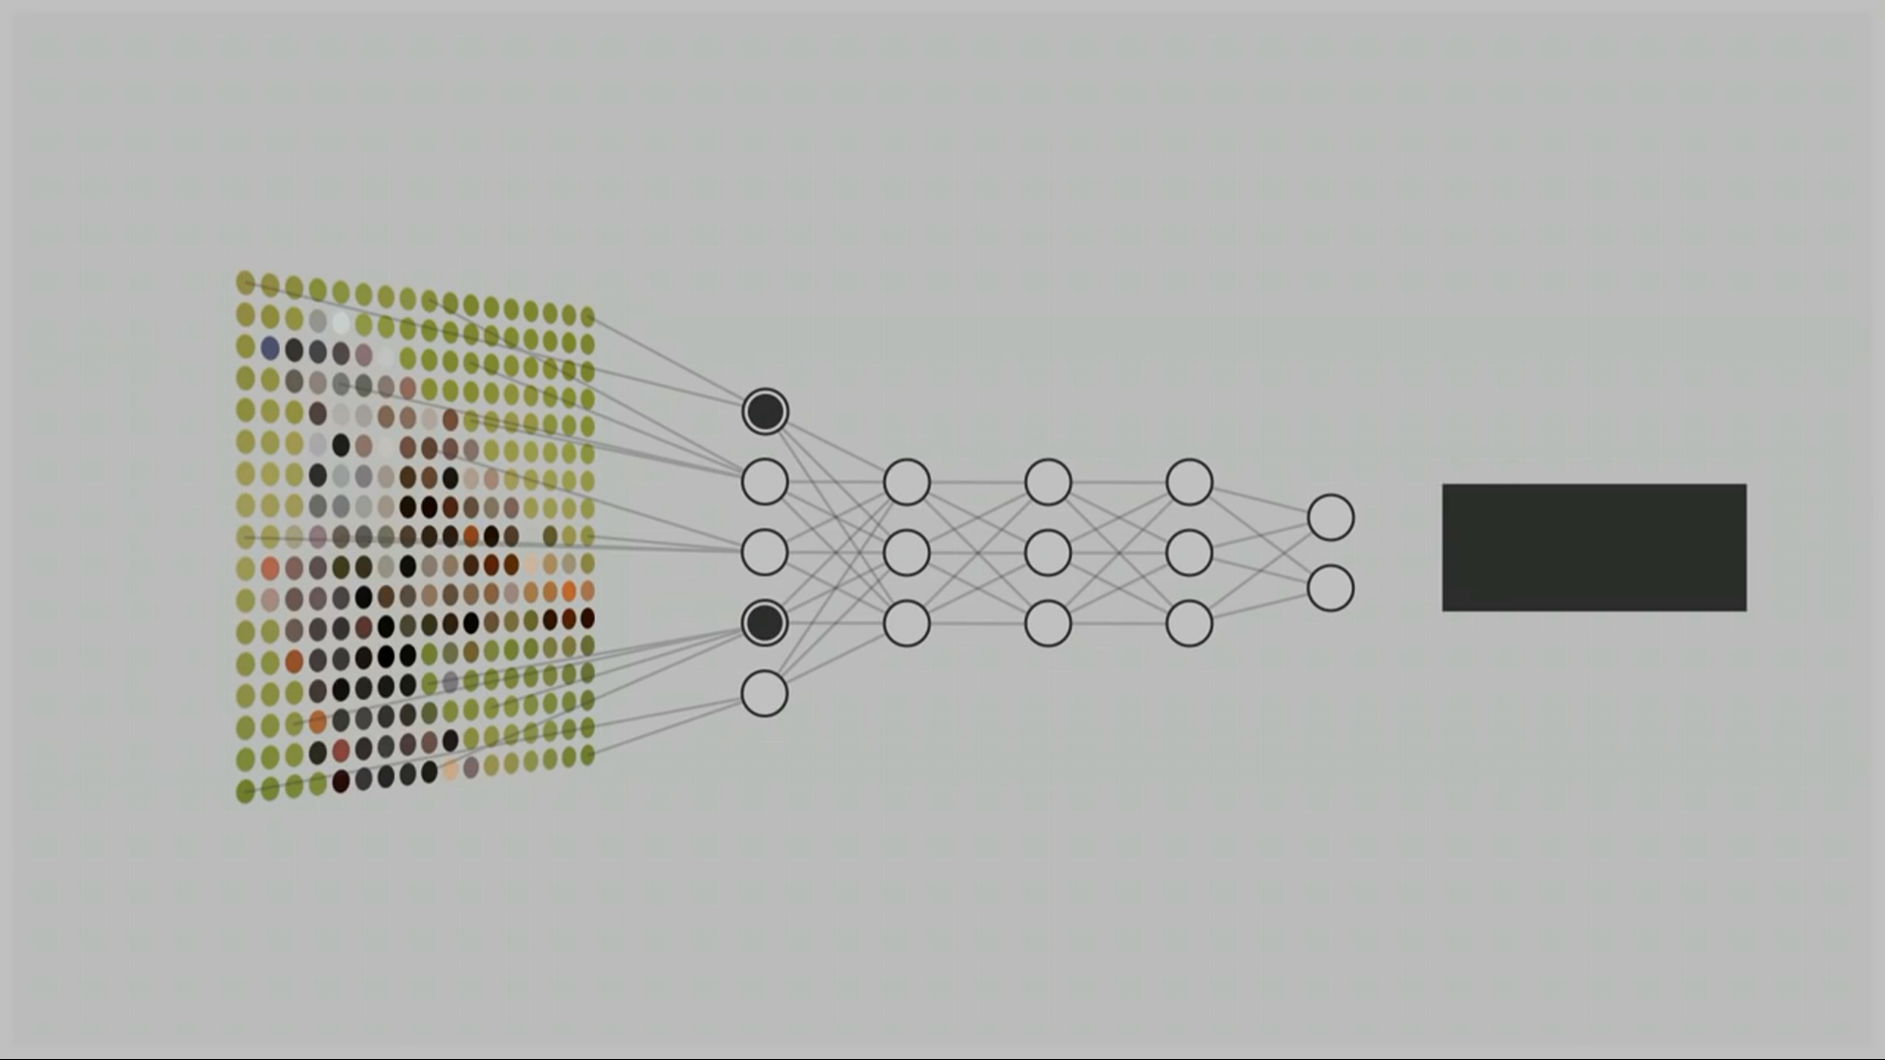
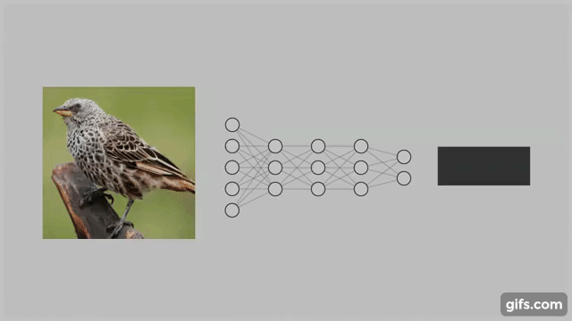
Intuition

Slide 35
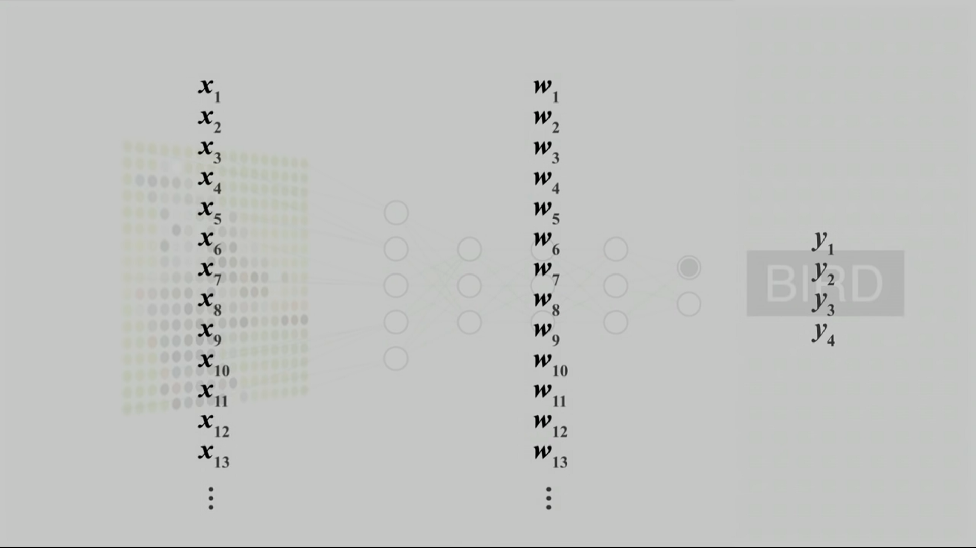
Intuition

Slide 36
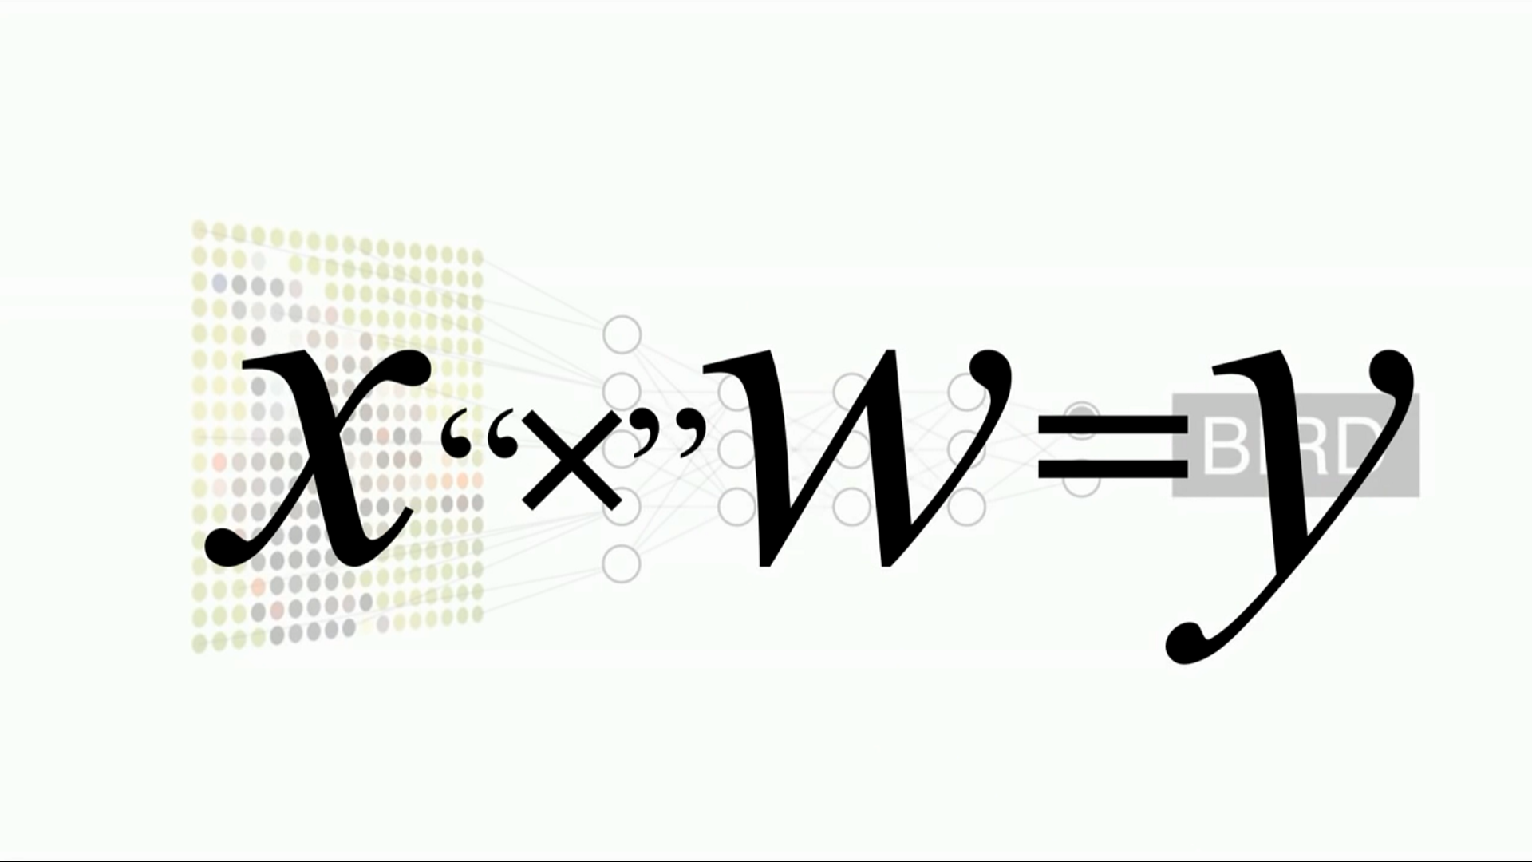
Intuition

Slide 37
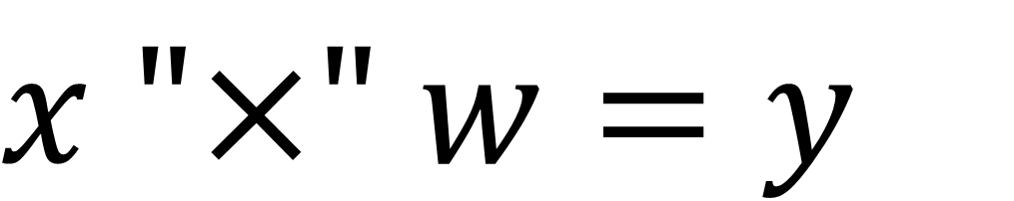
Intuition
$x \text{"}\text{×" }w=y$
known
known
unknown

Slide 38
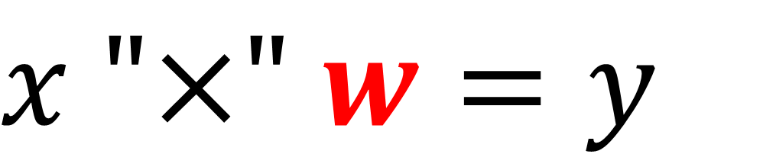
Intuition
$x \text{"}\text{×" }w=y$
Brain!!

Slide 39
Intuition
학습 (Learning)
$x \text{"}\text{×" }w=y$
known
unknown
known

Slide 40
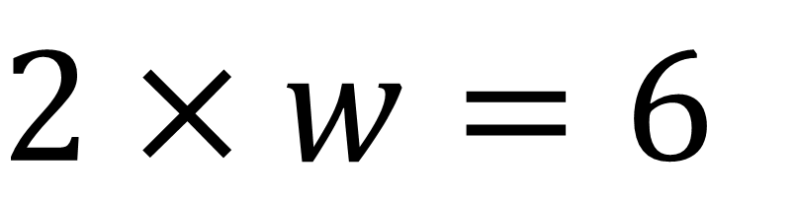
Intuition
학습 (Learning)
$2 \text{× }w=6$

Slide 41
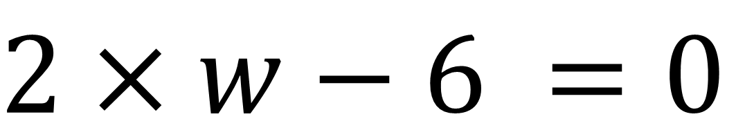
Intuition
학습 (Learning)
$2 \text{× }w−6 =0$

Slide 42
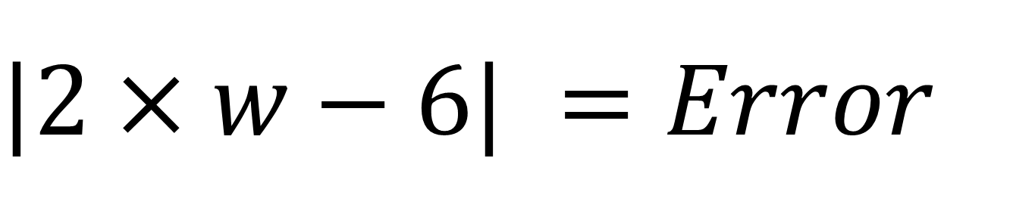
Intuition
학습 (Learning)
$|2 \text{× }w−6| =Error$

Slide 43
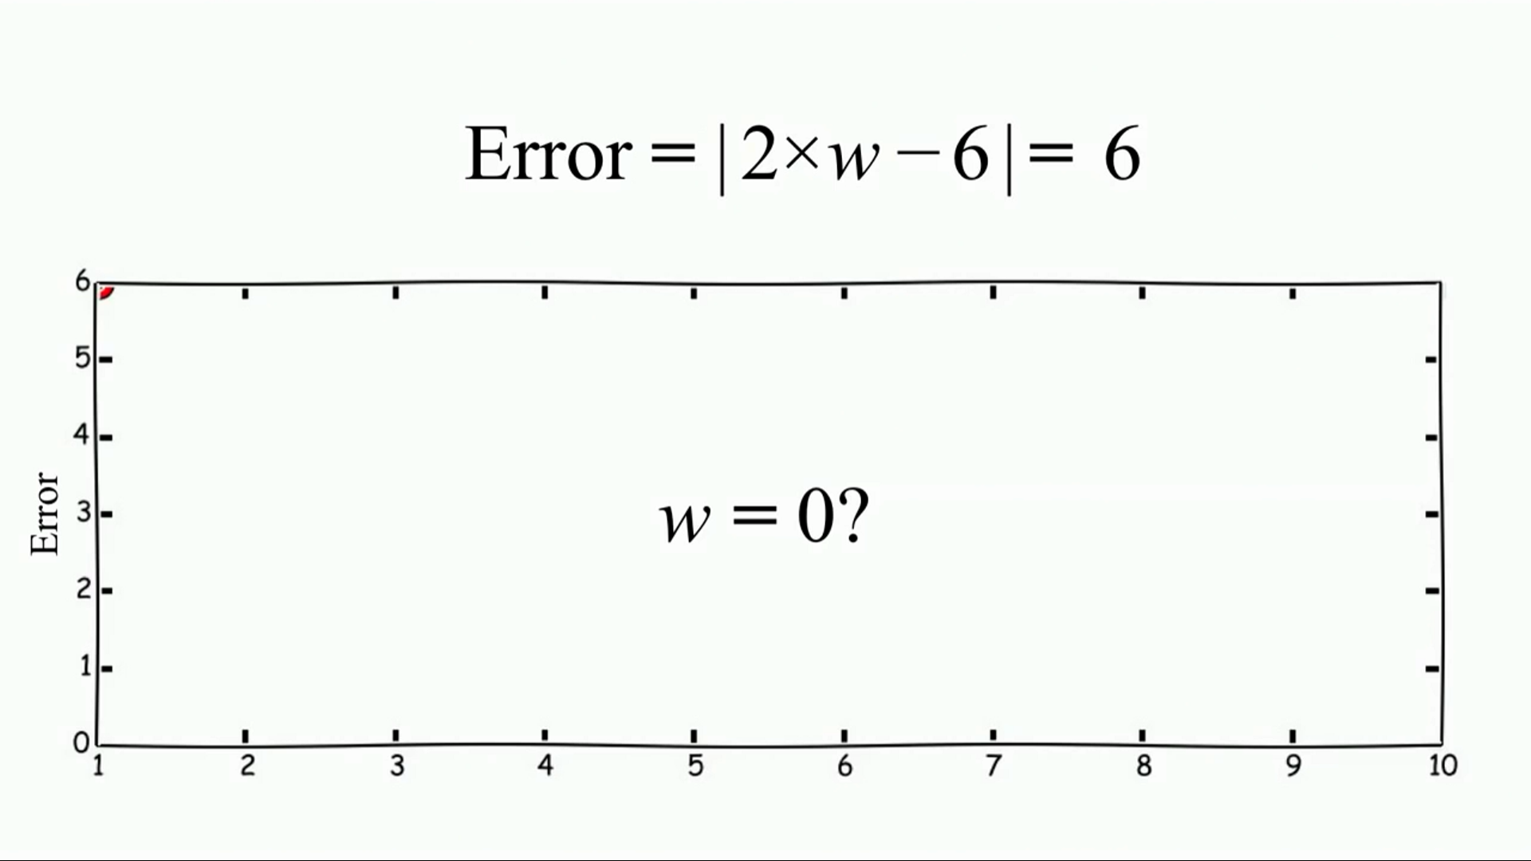
Intuition

Slide 44
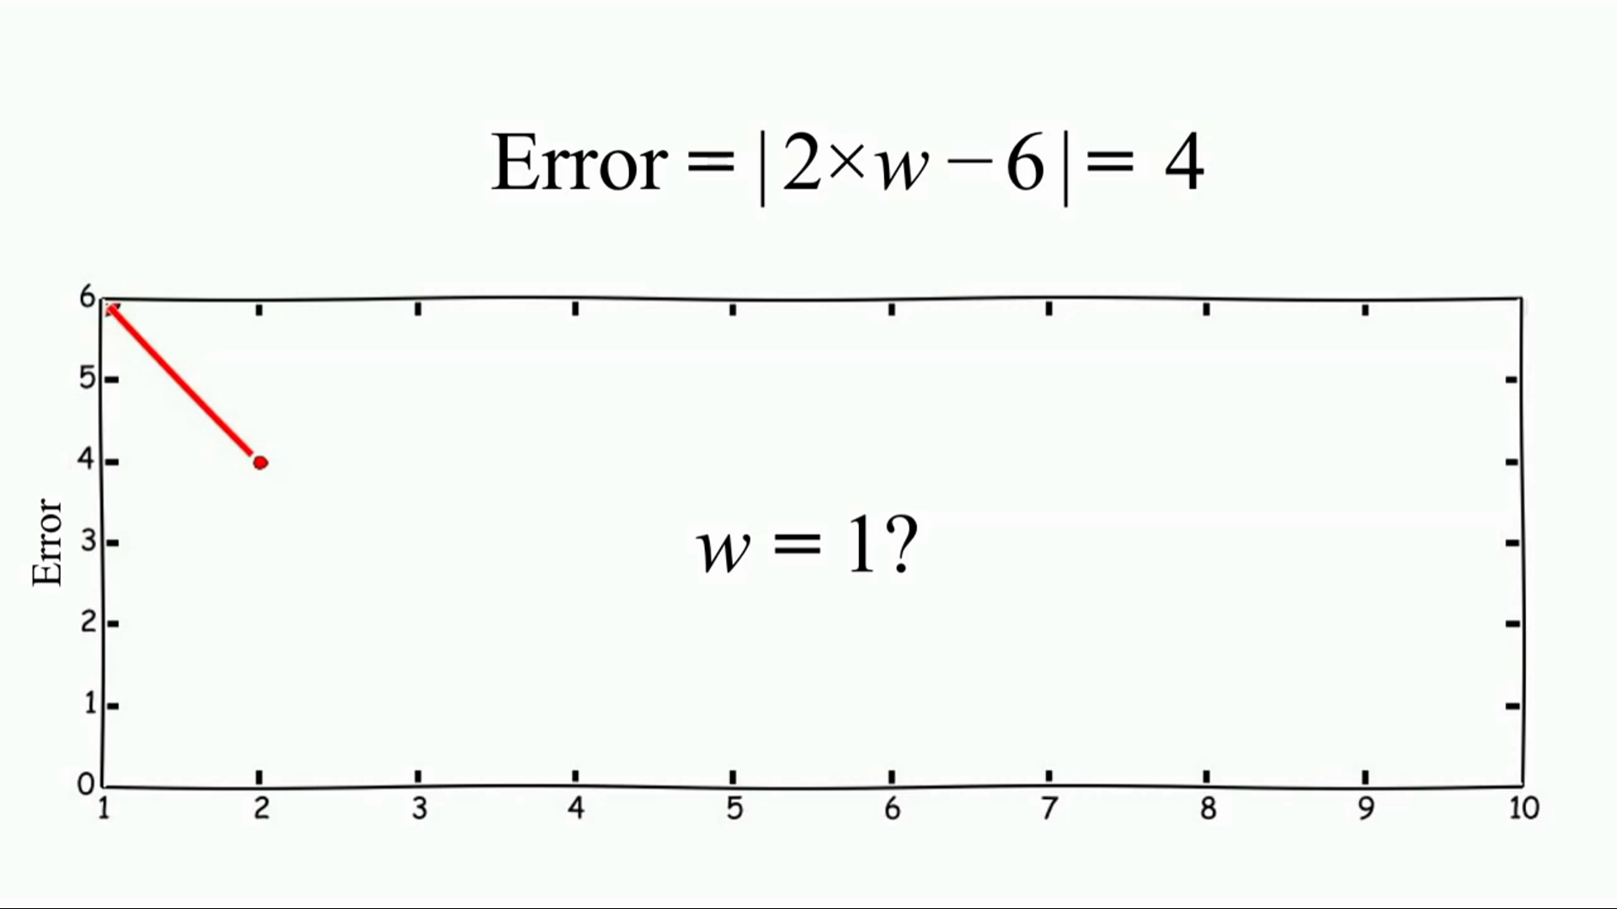
Intuition

Slide 45
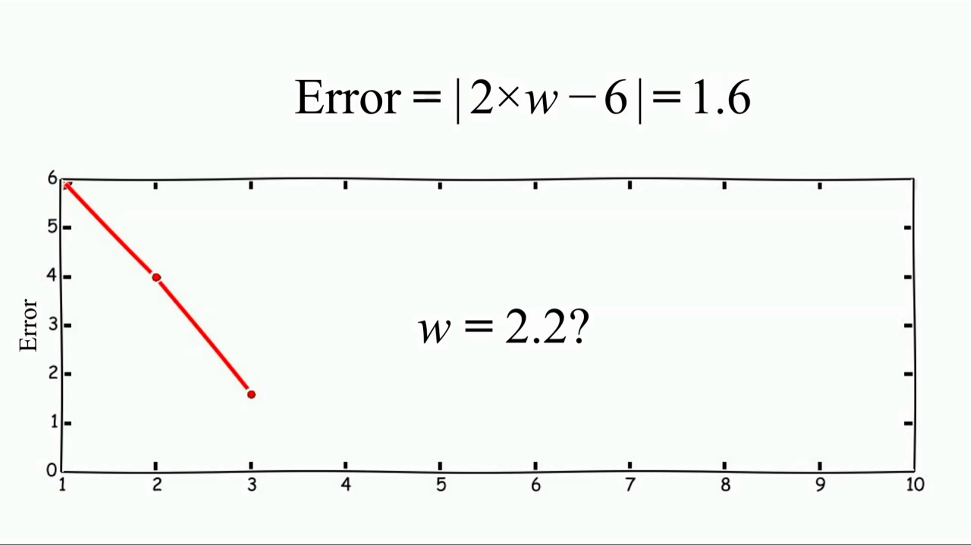
Intuition

Slide 46
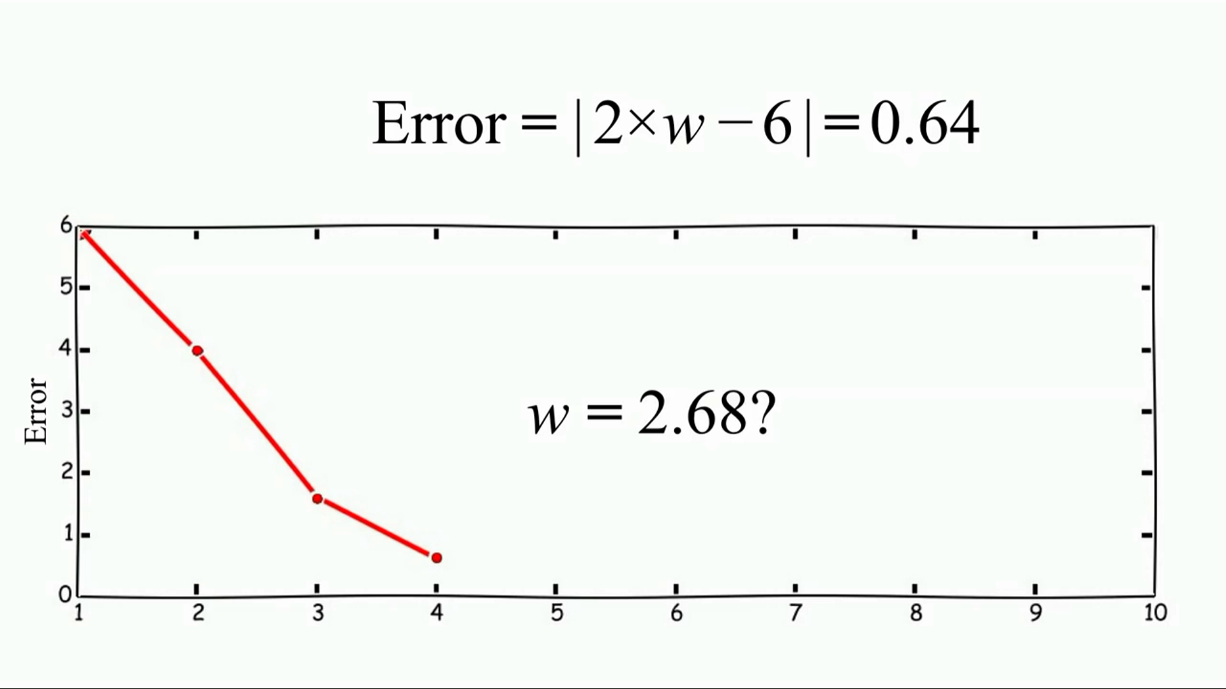
Intuition

Slide 47
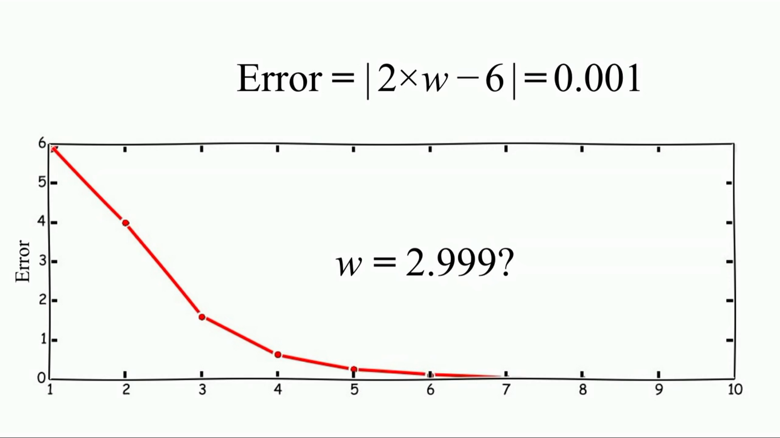
Intuition

Slide 48
